Slide 1
ARD
A1
Ali Baqar
Anahit Sarao
Maxwell Cheshier
Brian Josefowicz
Notes:
Everyone

Slide 2
Progress
We successfully got the PX4 software on the CrazyFlie 2.0 Hardware
Flashed the Bootloader and Firmware on the CrazyFlie
Got it communicate with the Flight Control Software via USB and bluetooth
We can either use a 5-channel radio or communicate through bluetooth
Hooked up 2nd CrazyFlie to the expansion board and ESC module
Currently waiting for GPS module to hook up to the CrazyFlie and use autonomous flight
Also got the PS3 controller working with the QGC and CrazyFlie 2.0
Ali Baqar
Notes:
Ali

Slide 3
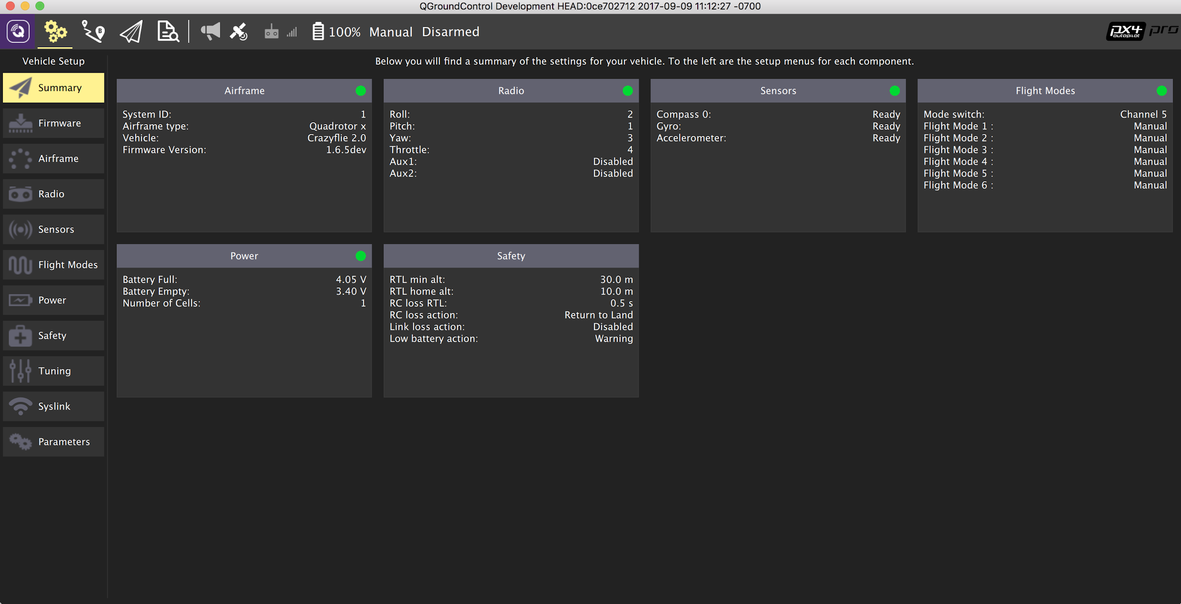
Progress and Current Status
We calibrated the sensors on the crazyflie to get the drone ready for take-off
Pix4 software requires the use of a GPS module for flying to specific location
Ali Baqar
Notes:
Ali

Slide 4
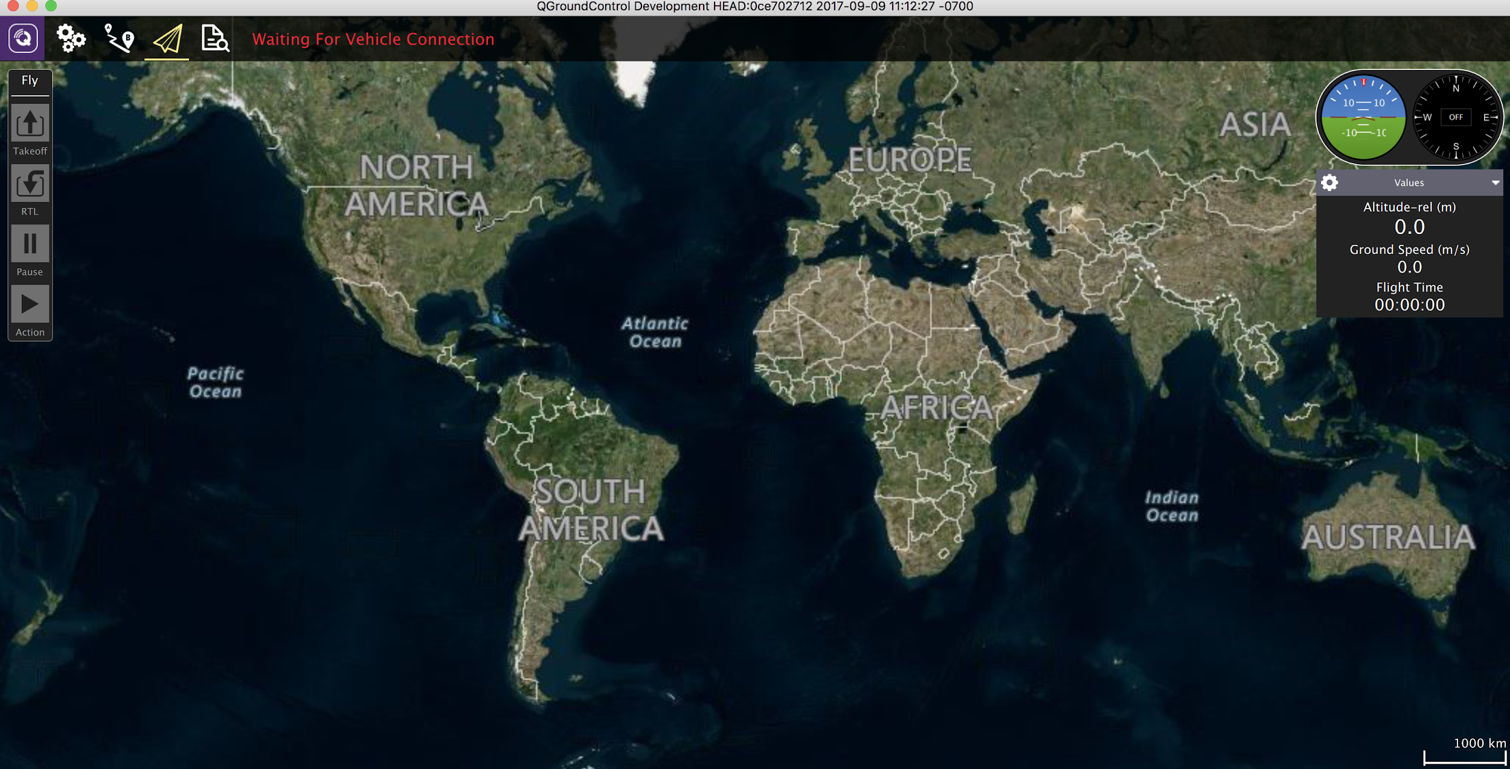
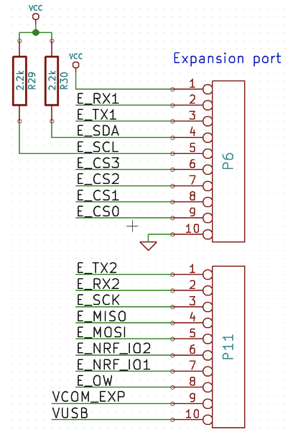
Current Status
https://github.com/s3nu/ARD
Custom Hardware Design In Progress
Proprietary Software on Github Repository
Still Need GPS models with external Sensors
Anahit Sarao
Notes:
Anahit

Slide 5
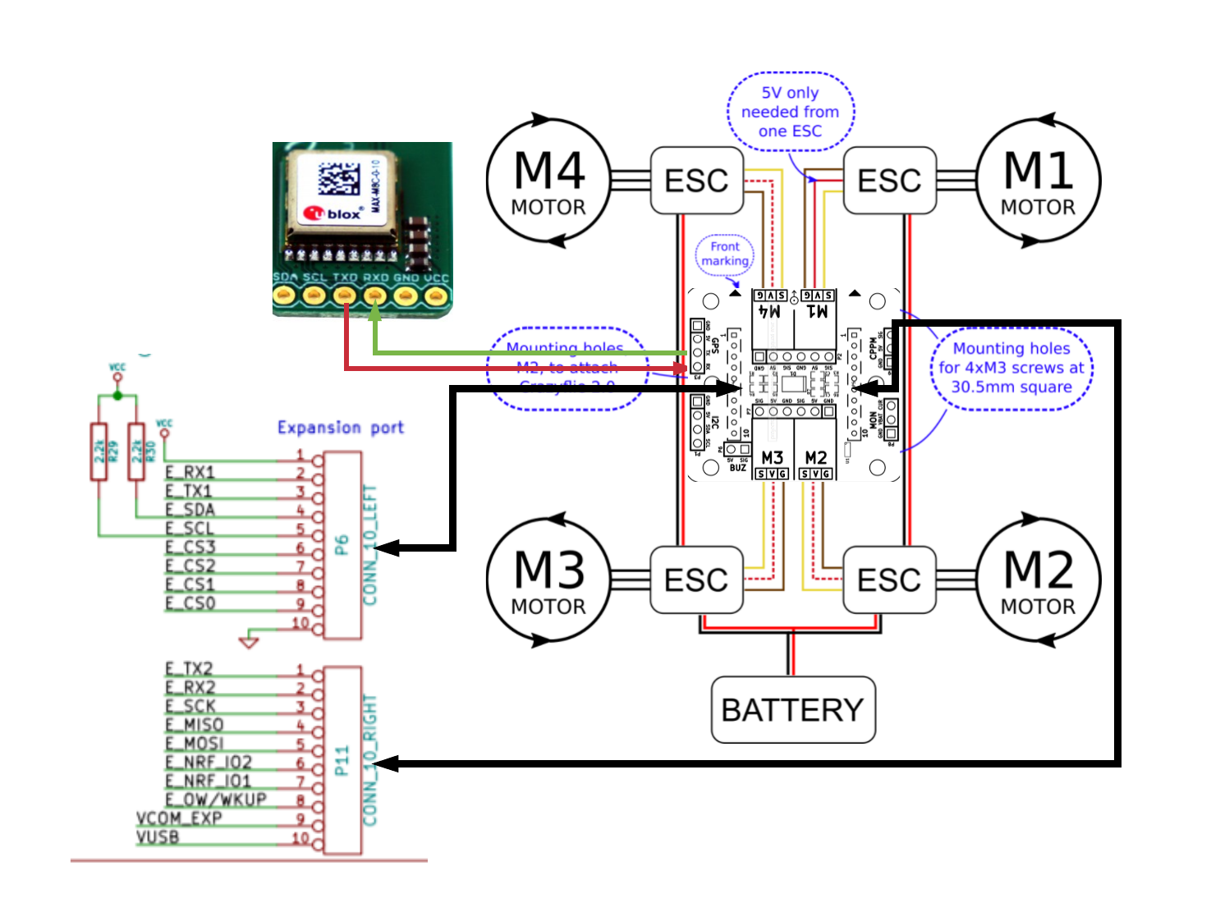
Custom Hardware Layout of Crazyflie 2.0
Brian
Notes:
Brian

Slide 6
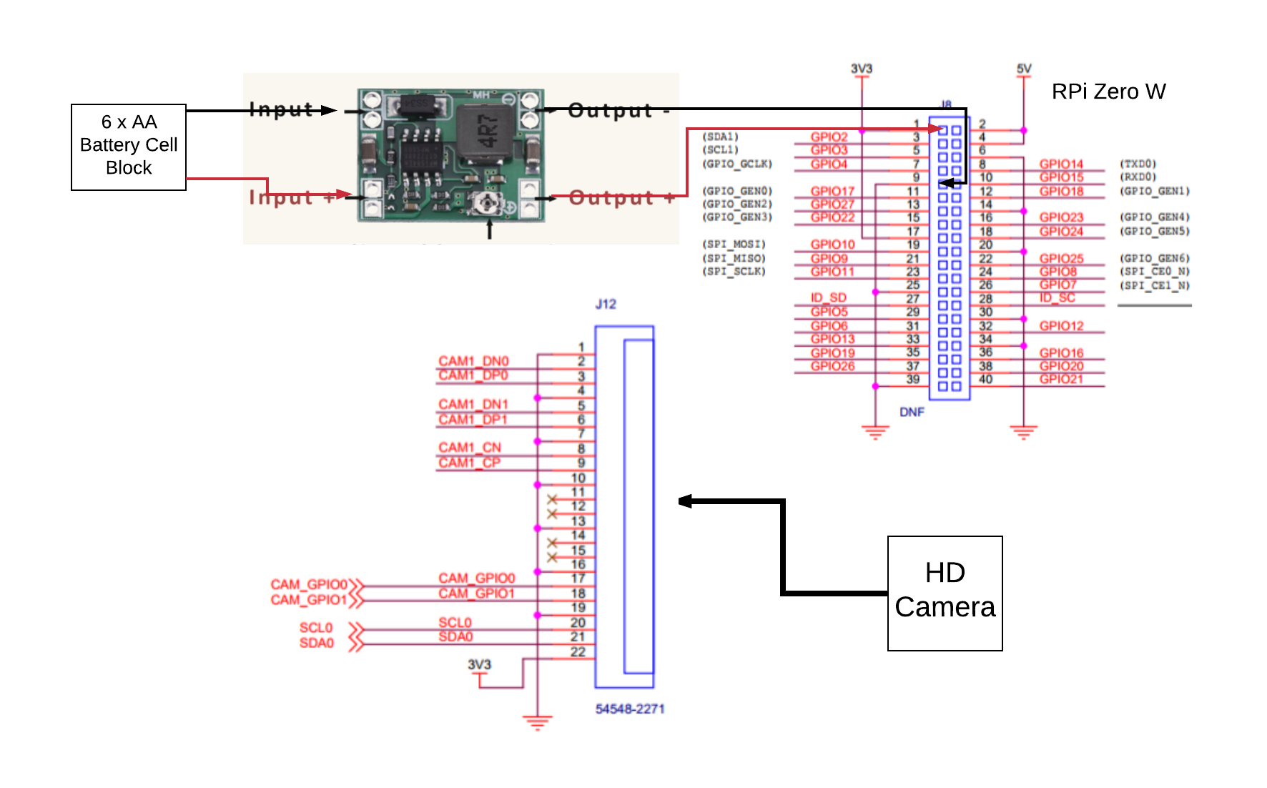
Custom hardware layout of Raspberry Pi Zero W
Brian
Notes:
Brian

Slide 7
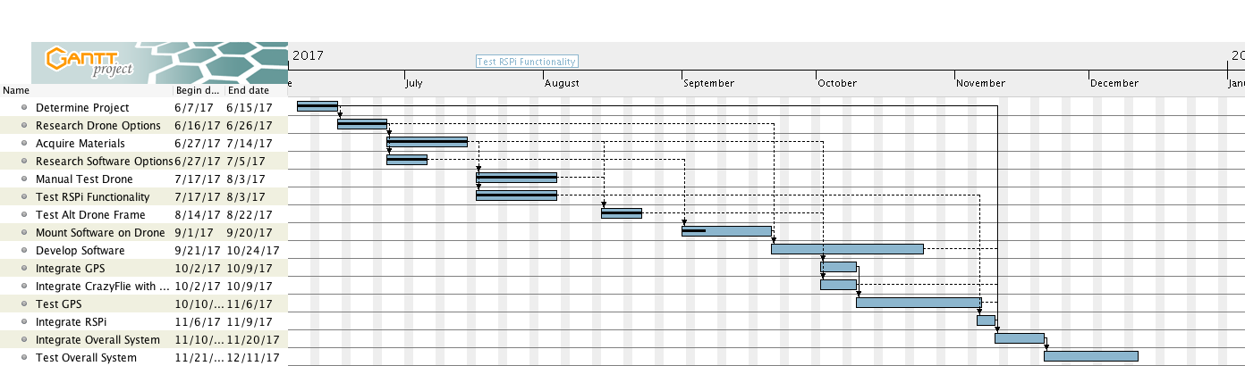
Gantt Chart
Maxwell Cheshier
Notes:
Max

Slide 8
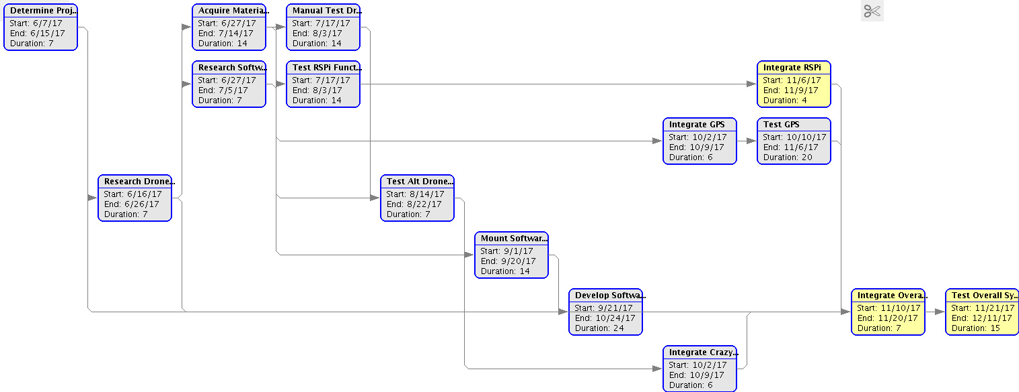
PERT Chart
Maxwell Cheshier
Notes:
Biran/Max

